Slide 1




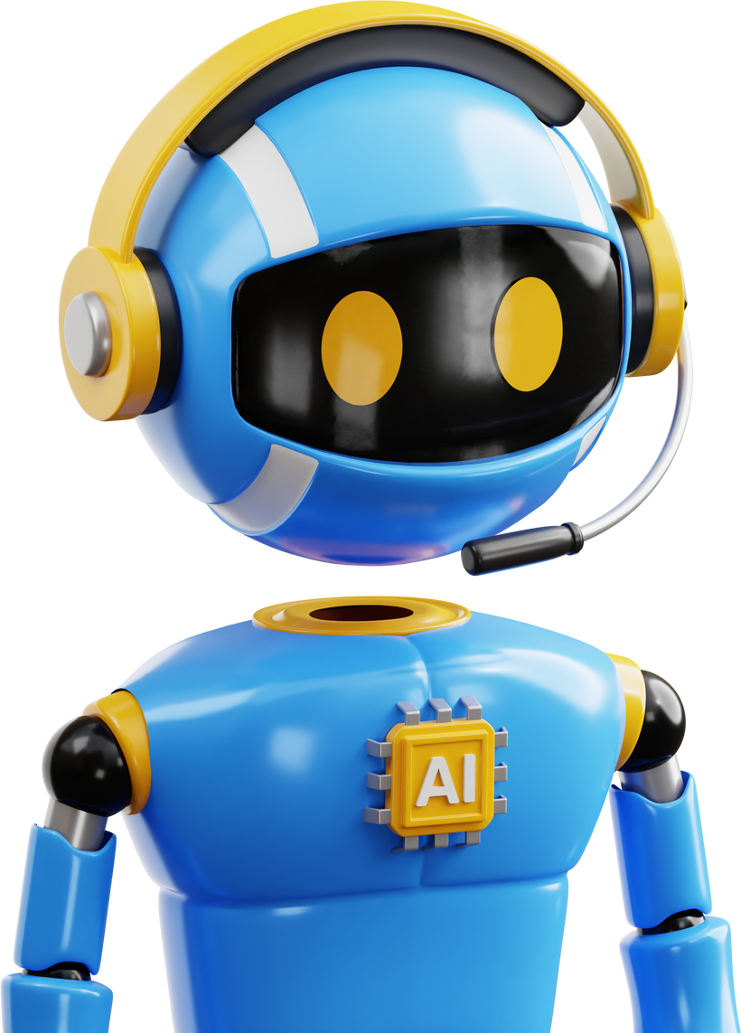


Get Started
AI EduBot
Team: EchoLogic
Abrar Alanazi
Albandari Altalhi
Your Interactive AI Tutor for YouTube Learning

Slide 2

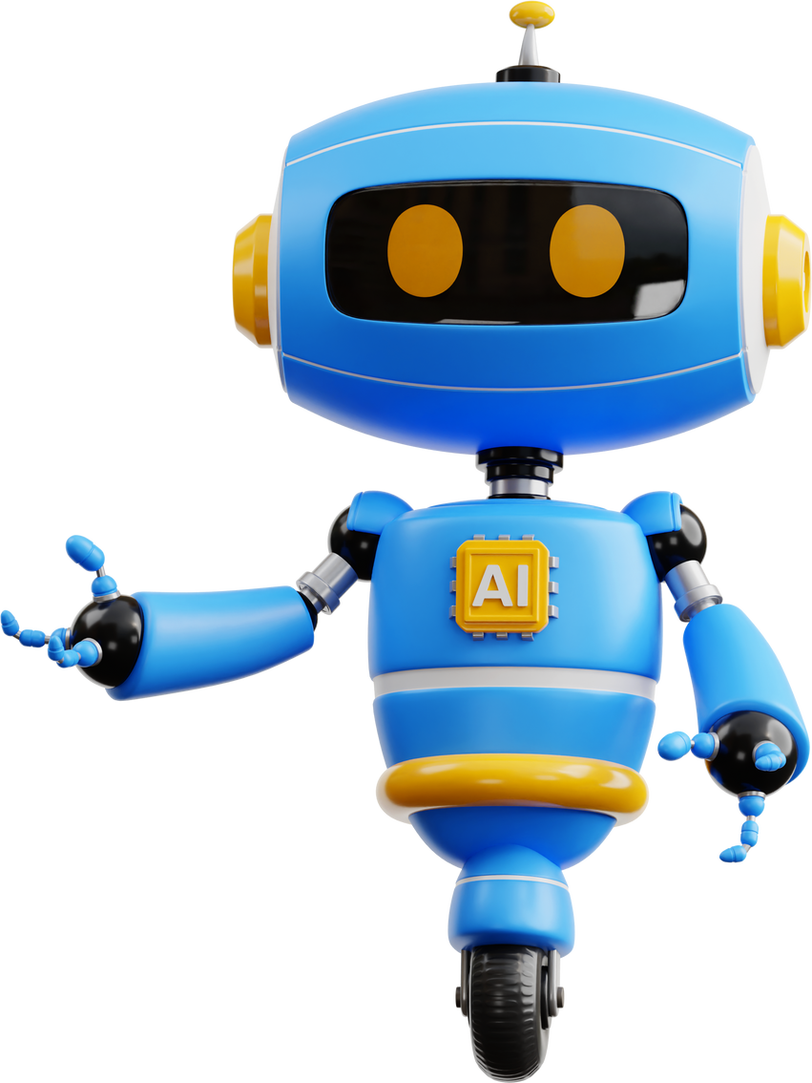
Education is evolving... and AI is becoming a fundamental part of this transformation.
We are EchoLogic, and it is our pleasure to present our project: AI EduBot.
This initiative goes beyond using artificial intelligence as a mere technical implementation. Instead, we have positioned AI as a strategic educational tool, aimed at transforming traditional, passive video-based learning into an engaging, interactive, and personalized educational experience.
Through AI EduBot, we seek to bridge the gap between static educational content and the evolving needs of modern learners by offering a system that responds intelligently to users’ inquiries based on actual video content.

Slide 3

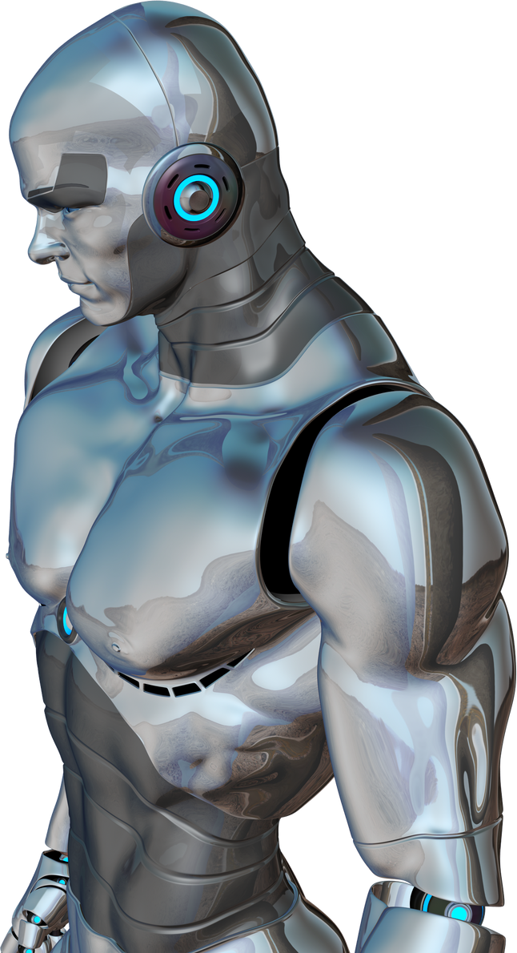
What is Artificial Intelligence (AI)?
Artificial Intelligence
Real-life examples:
a branch of computer science focused on creating systems and programs that can mimic human thinking and learning. These systems are designed to analyze data, make decisions, and solve problems in ways that resemble human intelligence."
YouTube video recommendations
Auto-translation with Google Translate
Text correction on smartphones
Smart assistants like Siri or Alexa

Slide 4




Saudi Arabia’s Role in AI & Education
The Kingdom is leading a digital transformation as part of Vision 2030:
SDAIA: Driving innovation in AI and education
Ministry of Education: Developing smart digital curricula
SCAI & STC AI: Investing in cutting-edge AI technologies
Saudi Digital Academy: Building a skilled AI workforce
EduBot aligns perfectly with this national vision for modern, AI-powered education.

Slide 5

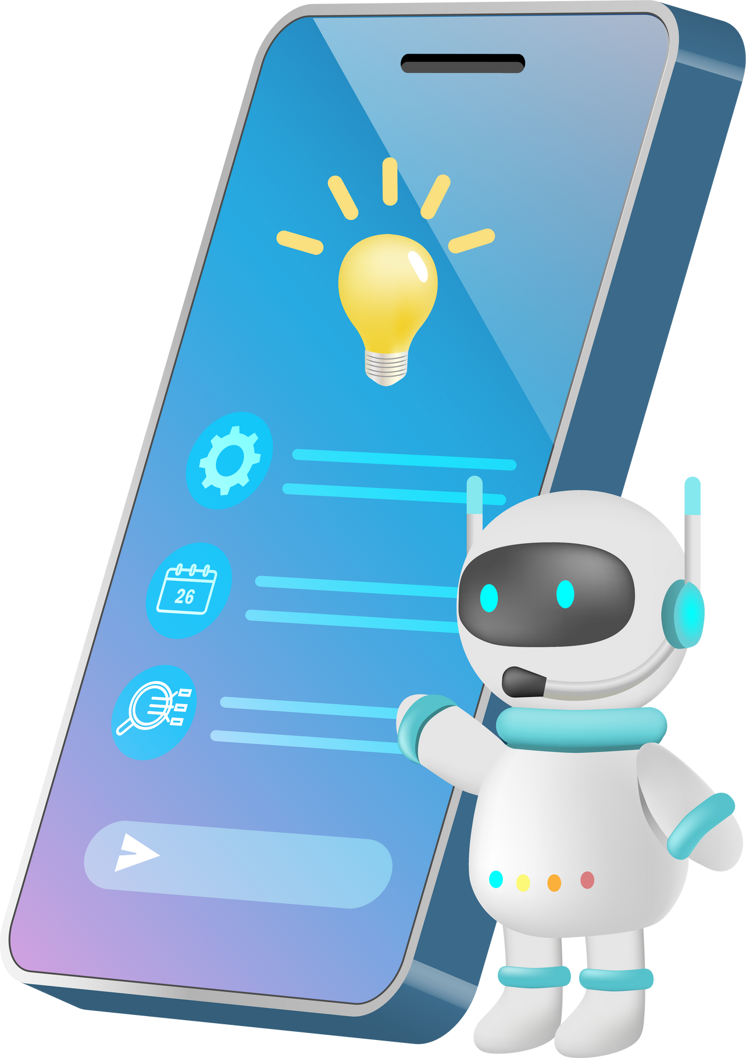
The reason we chose this project
We chose the AI EduBot project because it combines the power of artificial intelligence with education, aiming to create a smart assistant that can help students learn more effectively. This project allows us to explore how AI can personalize learning, answer students' questions, and provide support anytime, making education more accessible and interactive.

Slide 6
Why We Built This Project (Motivation)
There are millions of educational videos on YouTube, but they are often unorganized and hard to follow.
Learners may struggle to quickly find clear and accurate answers, especially in complex topics like AI.
We wanted to create a tool that lets users interact with video content—as if they were speaking directly to a tutor.
Goal: Make AI learning videos easier to understand, faster to benefit from, and more interactive.

Slide 7

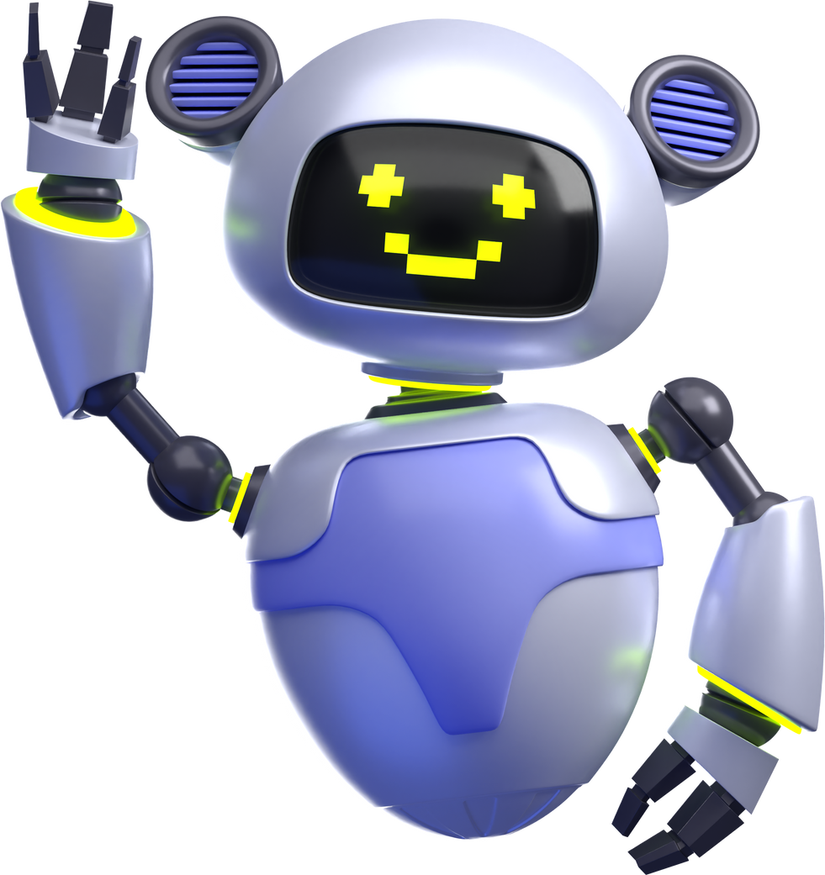
AI EduBot is a smart chatbot that acts as a personalized AI learning assistant:
What is AI EduBot?
It understands the content of YouTube videos.
Extracts and organizes key information.
Then answers your questions based on what the video says.
Imagine watching a video—and instead of rewinding or taking notes—you just ask, and get the answer!

Slide 8











SYSTEM EXTRACTS AUDIO FROM THE VIDEO
Audio is separated from the video file
1
AUDIO IS TRANSCRIBED TO TEXT USING WHISPER
OpenAI's Whisper model converts speech to written text
BLOCK DIAGRAM PROJECT WORKFLOW
2
The transcription is divided into manageable chunks for better processing.
TEXT IS SPLIT INTO SMALL PARAGRAPHS
3

Slide 9

4
PARAGRAPHS ARE STORED IN A SMART DATABASE (CHROMADB)
The chunks are embedded and stored using ChromaDB for semantic search.
The system retrieves the most relevant paragraph(s) based on the user’s question.
BLOCK DIAGRAM PROJECT WORKFLOW
5
WHEN A QUESTION IS ASKED, THE SYSTEM SEARCHES FOR THE BEST ANSWER
THE ANSWER IS DISPLAYED TO THE USER IN THE SUHAIL & REEM CHAT INTERFACE
The user receives a natural language response in the chatbot UI
6

Slide 10

Project Development Stages
Research & Analysis:
Tool Selection:
Whisper for audio transcription
LangChain for text chunking and parsing
ChromaDB for semantic search
GPT to generate answers
Understanding the challenge and reviewing existing solutions.

Slide 11
Project Development Stages
Prototyping:
Frontend Development:
Creating a user-friendly chat interface.
Integrating all components into a working model.
Testing & Evaluation:
Trying out real educational videos and measuring performance

Slide 12

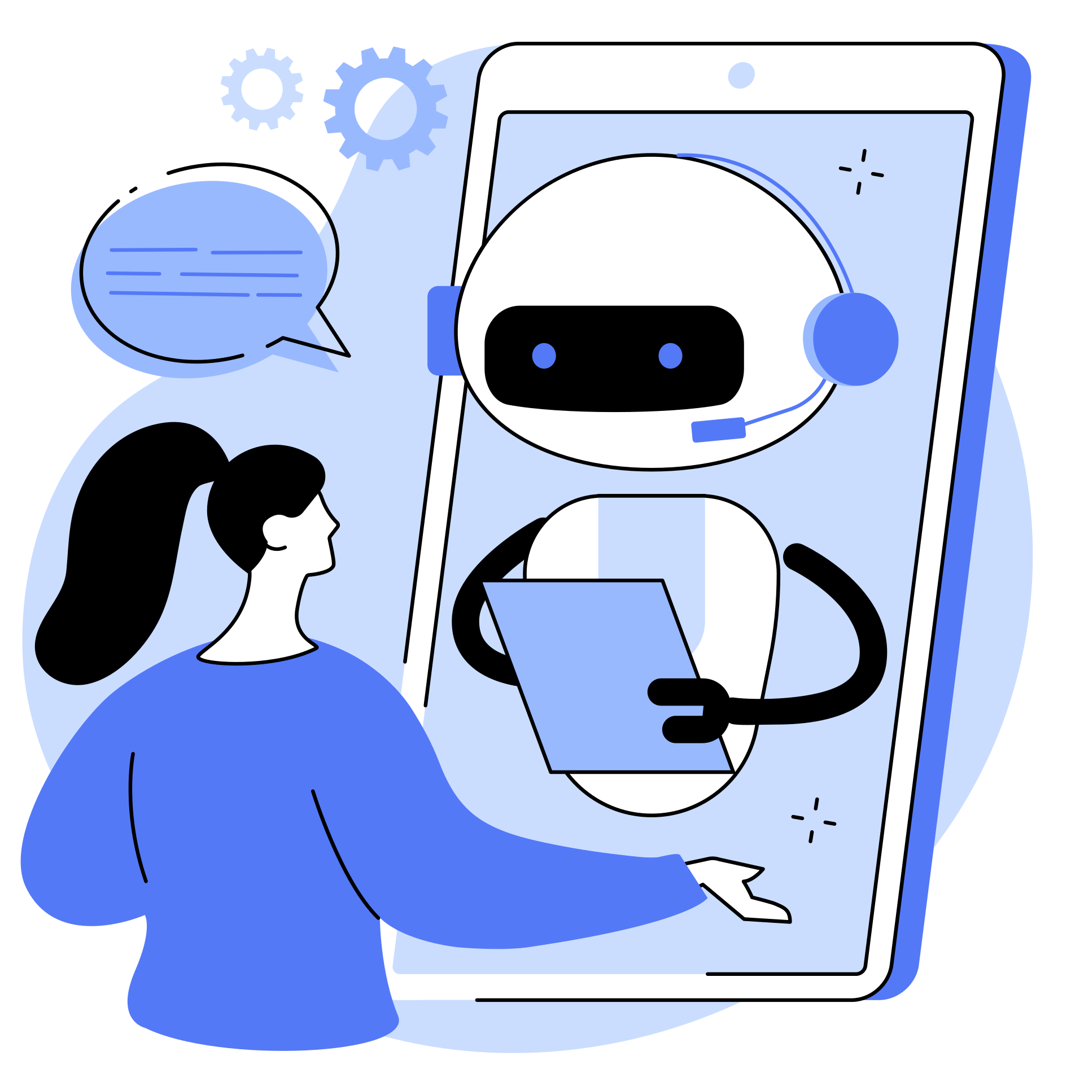


Use Cases
University Student: Needs simplified explanations for complex topics.
Teacher: Wants students to engage more with video content.
Self-learner: Follows online courses and seeks quick understanding.
Training companies: Want smarter interaction with training materials.

Slide 13

Challenges & How We Solved Them
Challenge
Solution
Poor audio/text quality
Long, scattered content
Finding the right answer
Used Whisper, a powerful OpenAI tool
Split into organized chunks
Applied smart retrieval with ChromaDB

Slide 14

Results & Achievements
Built a fully functional AI educational assistant
Successfully tested on real educational videos
Clean and easy-to-use chat interface
Clearly improves the self-learning experience

Slide 15

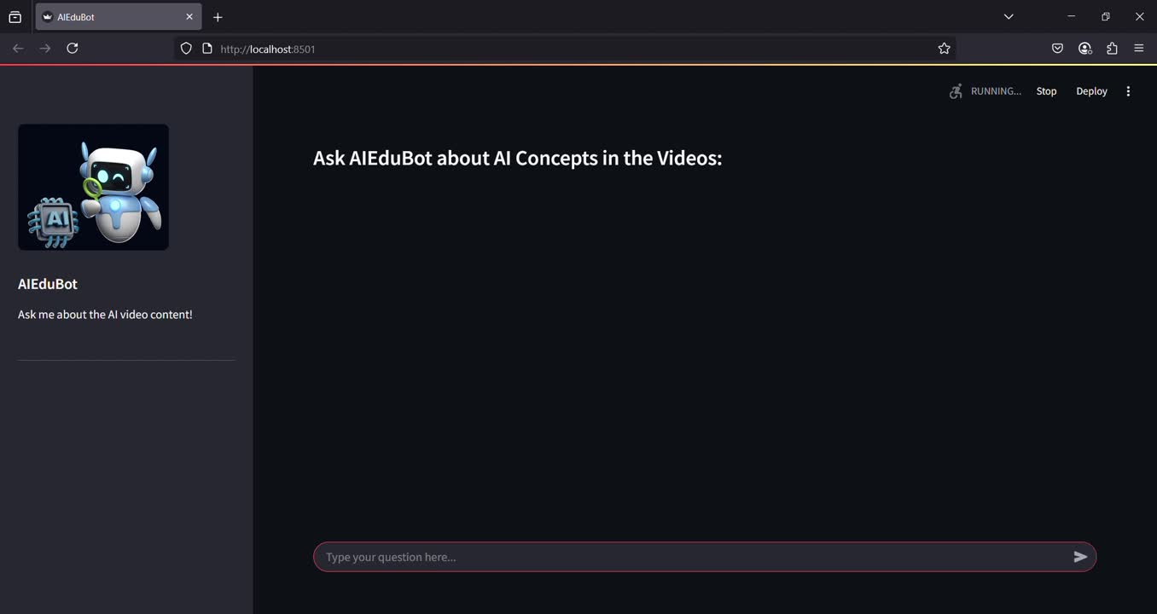

Live Demo

Slide 16

Future Expansion Ideas
Add auto-translation of video content
Generate video summaries
Support other content types (podcasts, e-books)
Integrate with platforms like Madrasati or FutureX
Build a mobile app for students and teachers

Slide 17
Conclusion
In a world where artificial intelligence is rapidly reshaping every aspect of life, we asked a simple yet powerful question:
Why can't video-based learning be smarter and more interactive?
This led to the creation of AI EduBot — an intelligent educational assistant that transforms video content into personalized, accessible knowledge. By leveraging advanced tools like Whisper, GPT, and ChromaDB, EduBot can understand, process, and respond to learners’ questions with speed and precision. Our project not only aligns with Saudi Vision 2030’s focus on digital transformation in education, but also marks a step toward making AI a true partner in learning — not to replace the teacher, but to empower the learner.

Slide 18


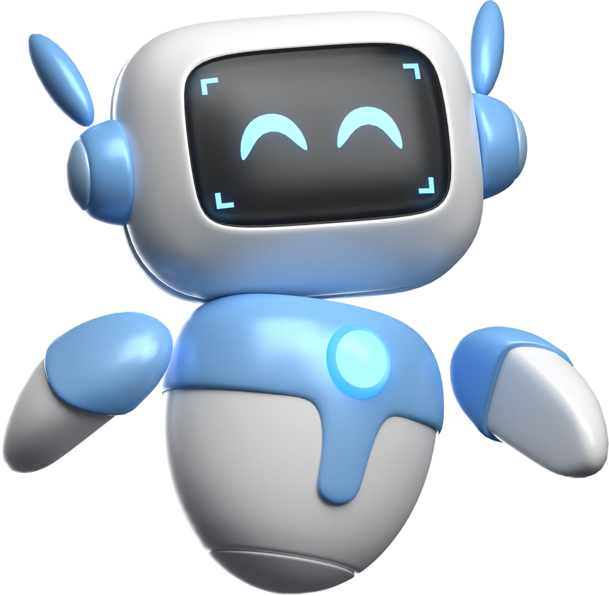

Thank You!

